Slide 1
RED HAT CLOUD SOLUTIONS
PRESENT AND FUTURE
@jameslabocki - Technology Strategy
Notes:
Share intros - “We want to spend some time this morning summarizing what Red Hat is doing to solve customers problems and give you a glimpse of what we will be delivering in the near future.” “the future is bright”

Slide 2
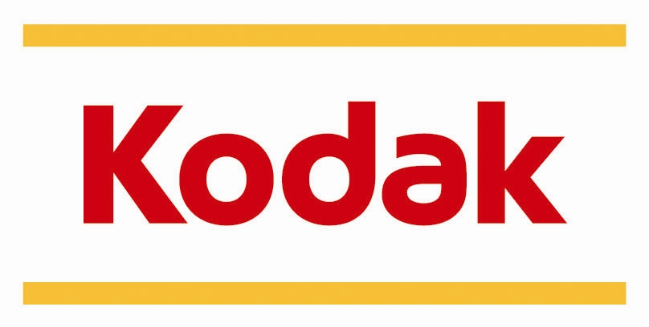
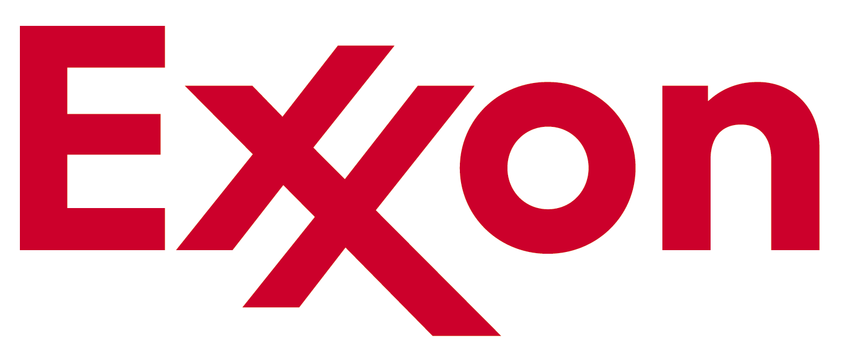





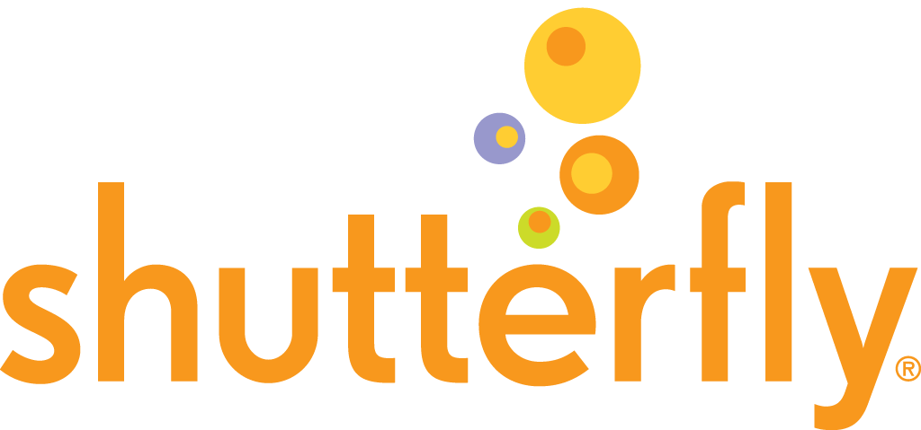



THE LANDSCAPE
You Need a Continuous Competitive Advantage
You Are a
Software Company
Your Competition is Everywhere
Notes:
The business environment has never been more competitive and disruptive than it is today. Businesses need to come to terms with three realities:
They need a continuous competitive advantage
Just ask Kodak who has seen the camera business transform from a standalone device to a feature on every mobile phone with new players like Snapfish, Shutterfly, and Chatbooks creating new ways of engaging with markets. If you don’t have a way of continually developing new competitive advantages you will not be relevant for long.
They are a software company
Bank of America is not just a bank, they are a transaction processing company. Exxon Mobil, is not only an oil and gas company, they are a GIS company. With each passing day Walgreens business is more reliant on electronic health records.
Their competition is everywhere
Ten years ago if I asked you who the biggest competitive threats were to Fedex names like UPS, and DHL might come to mind. Increasingly Fedex, UPS, and DHL face threats from Uber, Walmart, Amazon, and others who may enter their market of logistics with new ways of reaching customers.

Slide 3



BUSINESS UNDER PRESSURE
INCREASING EXPECTATIONS AND COMPETITION
LINE OF BUSINESS
DEVELOPERS
OPERATIONS
Transform to digital business
Deliver services faster at scale with lower incremental cost
Deliver applications faster
Speed up code creation and environment updates with modern languages and frameworks
Compete with public cloud providers in scalability and reliability
Public cloud like infrastructure with enterprise management features
Notes:
What do businesses need to do given these three realities?
To quote Mark Zuckerberg, they need to “Move fast and be stable”. Moving fast and being stable can be translated to more quickly developing new services that could be scaled to meet fast growing demand if needed but also with an extremely low cost of failure should they not work. In other words, cheap experiments need to be able to become global successes.

Slide 4
CURRENT PERFORMANCE
OVER BUDGET, OVER TIME, HALF THE VALUE
BUDGET
TIME
VALUE
45%
OVER
7%
OVER
56%
LESS
Source: Delivering large-scale IT projects on time, on budget, and on value
McKinsey & Company, October 2012
Notes:
The scientists conducting these cheap experiments are software developers. Lines of business naturally turn towards their development teams to request new services at an increasingly faster rate. The problem is, developers can’t obtain those environments fast enough from operations because traditional processes and non-flexible infrastructure and applications stand in the way. It’s no surprise then, according to a 2012 McKinsey and Company study [1], that software delivery in the enterprises surveyed was 45% over budget, 7% over on time, and has 56% less value than expected when delivered.

Slide 5
CLOUD AND DEVOPS ADOPTION
BUSINESSES LOOK FOR AN ANSWER
“93 percent of organizations surveyed are running applications or experimenting with Infrastructure-as-a-Service”
New Stats From The State Of Cloud Report, Forbes
“Platform-as-a-Service is expected to grow the fastest over the next five years, with 72% of respondents saying they expect to use PaaS in their organizations.”
North Bridge Venture Partners Future Of Cloud Computing Survey: SaaS Still The Dominant Cloud Platform, Forbes
93% of organizations expect to make net new investments in DevOps enabling technologies over the next two years
IDC DevOps Thought Leadership Survey, IDC, May, 2015
“71% of respondents anticipate using containers for cloud applications (or are already using them).”
Maximizing Container Benefits With A Top-Down Approach, a commissioned study conducted by Forrester Consulting on behalf of Red Hat
Notes:
This is no secret to businesses and they are looking to new methods and designs to help improve these metrics. In fact:
Over 90 percent are running or experimenting with Infrastructure as a Service [2].
Greater than 70 percent expect to use Platform as a Service in their organization [3].
More than 90 percent expect new investments in DevOps enabling technologies in the next two years [4].
Over 70 are using or anticipate using containers for cloud applications.

Slide 6
DEVOPS TO THE RESCUE
63%
Better Deployment Quality
VELOCITY AT AMAZON AWS
Max Deployments/Hour
10,000
63%
Faster Release Frequency
11.6
.001%
61%
Improved Process Visibility
Mean Time Between
Deployments (seconds)
Deployments Causing
an Outage
Source: 2014 State of DevOps Report
Puppet Labs, IT Revolution Press, ThoughtWorks
Notes:
Businesses are turning to new development and operations processes, new cloud infrastructures, and application methodologies that are conducive to these new processes and infrastructures. Looking at one of the leaders in public cloud, Amazon Web Services, we see they use these same principles and designs to achieve upwards of 10,000 releases per hour (as much as a release every 12 seconds) with a very low outage rate caused by these releases.

Slide 7


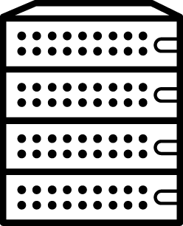
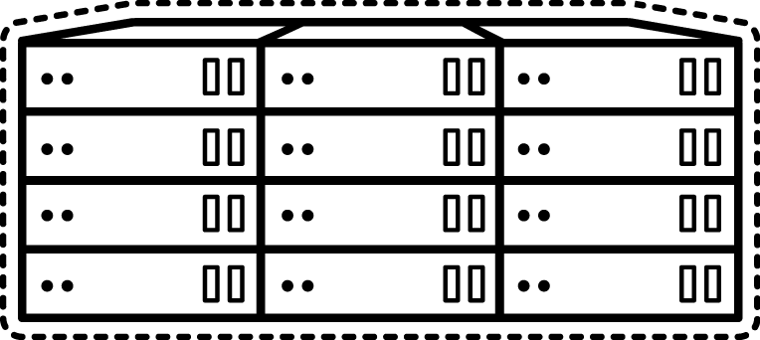


NOT SO FAST
ENTERPRISES HAVE EXISTING ASSETS
RELEVANCE
AGILITY
LESS COMPLEX
SCALABILITY
Physical
Virtual
Private
Public
Environments Delivered in Minutes Instead of Days or Weeks
“Mode 1 IT organizations should look to DevOps as a bridge to a Mode 2 orientation by continuing to assess where other patterns and practices of DevOps can enable a Mode 1 environment to deliver better service to customers”
DevOps in the
Bimodal Bridge (April 2015)
Implement Policy Driven Automation to Increase Efficiency
Create More Agile Development and Operations Processes
Programmable and Scalable Infrastructure and Platforms
Existing Apps
Cloud Native Apps
Mode-1
Mode-2
Notes:
At first glance it would appear that enterprises could simply yell “DevOps and Cloud to the Rescue!” and solve their problem of deploying faster on scalable infrastructure, but the reality is far from that. Enterprises have existing assets and investments, and many of these are not going away anytime soon. In fact, the existing systems and processes most likely power the very core of the business and cannot simply be replaced over night nor would they fit the paradigm of moving quickly and experimenting. Gartner coined the term Bi-modal to describe this approach of two modes of delivery for IT – one focused on agility and speed and the other on stability and accuracy
Gartner has also recognized an approach that enterprises can take that would allow them to maximize the use of their existing assets. In their research “DevOps in the Bimodal Bridge” [7] they suggest an approach where the patterns and practices of DevOps can be applied to existing assets (mode 1) to make it more agile and efficient.
In mode-1 they are looking to increase relevance and reduce complexity. In order to increase relevance they need to deliver environments for developers in minutes instead of days or weeks. In order to reduce complexity they need to implement policy driven automation to reduce the need for manual tasks.
In mode-2 they are looking to improve agility and increase scalability. In order to improve agility they need to create more agile development and operations processes and embrace new application architectures that allow for greater rates of change through decreased dependencies. In order to increase scalability they need to implement infrastructure that utilizes an asynchronous design and is entirely API driven in order to change the admin to host ratio from a linear to an exponential model in order to increase scalability.

Slide 8
THE CHALLENGE
ENABLING DEVOPS IN A BI-MODAL WORLD
ACCELERATE DELIVERY
RELEVANCE
AGILITY
MODERNIZE DEVELOPMENT
AND OPERATIONS
OPTIMIZE IT
LESS COMPLEX
SCALABILITY
DELIVER CLOUD INFRASTRUCTURE
AND APPLICATIONS
Physical
Virtual
Private
Public
Self-Service
Automation
Re-usable Descriptions
Configuration Management
Content Management
Microservices Architectures
Container Based Applications
Dynamic Scheduling
Continuous Integration and Delivery
Capacity Mgmt and Chargeback
Audit and Control Policies
Standard Operating Environment
Intelligent Workload Placement
Forecasting and Trending
Increased Performance/Security
Improved Vendor Relations
Asynchronous Design
API Driven Infrastructure
Software Defined Networking and Storage
Quota Enforcement
Analytics, Alerting, Monitoring
Notes:
Here is what they need to do and capabilities they need to deliver to meet these new challenges.

Slide 9

ACCELERATE SERVICE DELIVERY
EXAMPLE
Task | Time (Minutes)
Create Virtual Machine | 30
Add Storage and Networking | 30
Queue Between Teams | 120
Install Operating System | 60
Wait After Install | 60
Configure Operating System | 90
Install Application Platforms | 90
Configure Application Platforms | 45
Queue Between Teams | 120
Security Configuration and Scan | 90
Active Work Time | 5 Hours 15 Minutes
Total Time | 10 Hours
Service
Management
Request
“What Networks should this be on?”
VI Admin
“Do you really need 16GB?”
“What version of Java again?”
Developer
“What goes into this config file?”
Sys Admin
“This is not configured securely”
“This version is insecure”
Sec Ops
The Head of Development is complaining that developers are waiting to get development environments and it’s slowing time to market
My administrator and security operations teams made a few mistakes
Head of
Operations
Notes:
Increasing Relevance by Accelerating Service Delivery
Delivering development and test environments to developers in many enterprises generally starts with either a request to a service management system or a tap on the shoulder of a system administrator. This usually depends on the size of the organization and maturity of the IT department. Either way, once requests fall into a service management system there are often many teams that need to perform tasks to deliver the environment to the developer. These might include virtual infrastructure administrators, systems administrators, and security operations. In larger organizations you could expect to see disaster recovery teams, networking teams, and many others involved in this process too. Again, depending on the maturity of the organization how all of this is coordinated could range from taps on shoulders to passing tickets around in a service management system.
At best each team takes minutes or hours to respond and perform some manual tasks and often the person who requests the service must be asked follow up questions (“Are you sure you need 16GB of RAM?”, “What version of Java do you need for this?”). The result is lots of highly skilled people spending lots of time and very slow delivery of this environment to the developer. Multiply this by the number of developers in an organization and the number of requests for environments and you can understand why traditional IT processes and systems are struggling to maintain relevance.
A solution for this problem is to introduce a service designer into the process (you may be familiar with this from ITIL) that can enable self-service consumption of everything developers need. The designer works with all stakeholders including virtual infrastructure administrators, system administrators, and security operations to obtain requirements. Then, the designer builds the necessary configuration management content and couples it with a service catalog item. By invoking this catalog item the environment can be deployed automatically across any number of providers including virtualization providers, private, or public cloud.
The result of this solution is that all the teams responsible for delivering an environment are now free to do more valuable work (like working with development to design operations processes that work as part of development instead of being bolted on after). It also removes human error from the equation, and most importantly, it delivers the environment in significantly less time. We have seen upwards of a 95 percent improvement in delivery times in many of our customers [9].

Slide 10
ACCELERATE SERVICE DELIVERY
EXAMPLE
Service
Management
Request
Request
Request
Request
“Approve”
“Approve”
“Approve”
Developer Environment
Requirements
VI Admin
Sys Admin
Sec Ops
VI and System
Requirements
Security
Requirements
Developer
Developer Environment
Creation
Service
Designer
Hybrid Cloud Infrastructure
Automation
Catalog Item
Notes:
Increasing Relevance by Accelerating Service Delivery
Delivering development and test environments to developers in many enterprises generally starts with either a request to a service management system or a tap on the shoulder of a system administrator. This usually depends on the size of the organization and maturity of the IT department. Either way, once requests fall into a service management system there are often many teams that need to perform tasks to deliver the environment to the developer. These might include virtual infrastructure administrators, systems administrators, and security operations. In larger organizations you could expect to see disaster recovery teams, networking teams, and many others involved in this process too. Again, depending on the maturity of the organization how all of this is coordinated could range from taps on shoulders to passing tickets around in a service management system.
At best each team takes minutes or hours to respond and perform some manual tasks and often the person who requests the service must be asked follow up questions (“Are you sure you need 16GB of RAM?”, “What version of Java do you need for this?”). The result is lots of highly skilled people spending lots of time and very slow delivery of this environment to the developer. Multiply this by the number of developers in an organization and the number of requests for environments and you can understand why traditional IT processes and systems are struggling to maintain relevance.
A solution for this problem is to introduce a service designer into the process (you may be familiar with this from ITIL) that can enable self-service consumption of everything developers need. The designer works with all stakeholders including virtual infrastructure administrators, system administrators, and security operations to obtain requirements. Then, the designer builds the necessary configuration management content and couples it with a service catalog item. By invoking this catalog item the environment can be deployed automatically across any number of providers including virtualization providers, private, or public cloud.
The result of this solution is that all the teams responsible for delivering an environment are now free to do more valuable work (like working with development to design operations processes that work as part of development instead of being bolted on after). It also removes human error from the equation, and most importantly, it delivers the environment in significantly less time. We have seen upwards of a 95 percent improvement in delivery times in many of our customers [9].

Slide 11
ACCELERATE SERVICE DELIVERY
EXAMPLE
Task | Time (Minutes)
Create Virtual Machine | 1
Add Storage and Networking | 1
Queue Between Teams | 60
Install Operating System | 5
Wait After Install | 30
Configure Operating System | 3
Install Application Platforms | 4
Configure Application Platforms | 5
Queue Between Teams | 90
Security Configuration and Scan | 2
Active Work Time | 0
Total Time | 21 Minutes
Service
Management
Request
Developer
Reduced Human Error
Removed Active Work Time
Cut Total Time By >95%
Head of
Operations
Notes:
Increasing Relevance by Accelerating Service Delivery
Delivering development and test environments to developers in many enterprises generally starts with either a request to a service management system or a tap on the shoulder of a system administrator. This usually depends on the size of the organization and maturity of the IT department. Either way, once requests fall into a service management system there are often many teams that need to perform tasks to deliver the environment to the developer. These might include virtual infrastructure administrators, systems administrators, and security operations. In larger organizations you could expect to see disaster recovery teams, networking teams, and many others involved in this process too. Again, depending on the maturity of the organization how all of this is coordinated could range from taps on shoulders to passing tickets around in a service management system.
At best each team takes minutes or hours to respond and perform some manual tasks and often the person who requests the service must be asked follow up questions (“Are you sure you need 16GB of RAM?”, “What version of Java do you need for this?”). The result is lots of highly skilled people spending lots of time and very slow delivery of this environment to the developer. Multiply this by the number of developers in an organization and the number of requests for environments and you can understand why traditional IT processes and systems are struggling to maintain relevance.
A solution for this problem is to introduce a service designer into the process (you may be familiar with this from ITIL) that can enable self-service consumption of everything developers need. The designer works with all stakeholders including virtual infrastructure administrators, system administrators, and security operations to obtain requirements. Then, the designer builds the necessary configuration management content and couples it with a service catalog item. By invoking this catalog item the environment can be deployed automatically across any number of providers including virtualization providers, private, or public cloud.
The result of this solution is that all the teams responsible for delivering an environment are now free to do more valuable work (like working with development to design operations processes that work as part of development instead of being bolted on after). It also removes human error from the equation, and most importantly, it delivers the environment in significantly less time. We have seen upwards of a 95 percent improvement in delivery times in many of our customers [9].

Slide 12


ACCELERATE SERVICE DELIVERY
“Our internal experts were spending too much time managing inefficient processes. We needed a solution that would help us standardize and automate these processes so we could reduce our time to market for new applications.”
DON O’CONNOR
MANAGING DIRECTOR
TECHNOLOGY OPERATIONS
“We used to require around 60 days from a physical server request to the actual installation. With Red Hat Enterprise Virtualization and support through Red Hat CloudForms, provisioning now is almost 95% faster than it used to be.”
WORATHEP ARAMKUL
CLIENT MANAGEMENT AND BUSINESS
DEVELOPMENT MANAGER, G-ABLE
“We have eliminated manual processes and bottlenecks by leveraging automation. Delivery of new application environments which used to take weeks, now takes a few hours.”
FRANK VENDITTI,
CHIEF INFRASTRUCTURE ARCHITECT
UNION BANK
https://www.redhat.com/en/files/resources/en-rhcf-union-bank-12308517.pdf
http://www.redhat.com/en/resources/g-able-improves-resource-allocation-red-hat-solutions
Notes:
Increasing Relevance by Accelerating Service Delivery
Delivering development and test environments to developers in many enterprises generally starts with either a request to a service management system or a tap on the shoulder of a system administrator. This usually depends on the size of the organization and maturity of the IT department. Either way, once requests fall into a service management system there are often many teams that need to perform tasks to deliver the environment to the developer. These might include virtual infrastructure administrators, systems administrators, and security operations. In larger organizations you could expect to see disaster recovery teams, networking teams, and many others involved in this process too. Again, depending on the maturity of the organization how all of this is coordinated could range from taps on shoulders to passing tickets around in a service management system.
At best each team takes minutes or hours to respond and perform some manual tasks and often the person who requests the service must be asked follow up questions (“Are you sure you need 16GB of RAM?”, “What version of Java do you need for this?”). The result is lots of highly skilled people spending lots of time and very slow delivery of this environment to the developer. Multiply this by the number of developers in an organization and the number of requests for environments and you can understand why traditional IT processes and systems are struggling to maintain relevance.
A solution for this problem is to introduce a service designer into the process (you may be familiar with this from ITIL) that can enable self-service consumption of everything developers need. The designer works with all stakeholders including virtual infrastructure administrators, system administrators, and security operations to obtain requirements. Then, the designer builds the necessary configuration management content and couples it with a service catalog item. By invoking this catalog item the environment can be deployed automatically across any number of providers including virtualization providers, private, or public cloud.
The result of this solution is that all the teams responsible for delivering an environment are now free to do more valuable work (like working with development to design operations processes that work as part of development instead of being bolted on after). It also removes human error from the equation, and most importantly, it delivers the environment in significantly less time. We have seen upwards of a 95 percent improvement in delivery times in many of our customers [9].

Slide 13
THE CHALLENGE
ENABLING DEVOPS IN A BI-MODAL WORLD
ACCELERATE DELIVERY
RELEVANCE
AGILITY
MODERNIZE DEVELOPMENT
AND OPERATIONS
OPTIMIZE IT
COMPLEXITY
SCALABILITY
DELIVER CLOUD INFRASTRUCTURE
AND APPLICATIONS
Physical
Virtual
Private
Public
Self-Service
Automation
Re-usable Descriptions
Configuration Management
Content Management
Red Hat Cloud Infrastructure
Red Hat CloudForms
Red Hat Satellite
Red Hat Enterprise Virtualization
RHEL OpenStack Platform
Red Hat Enterprise Linux
Red Hat Storage
Microservices Architectures
Container Based Applications
Dynamic Scheduling
Continuous Integration and Delivery
Capacity Mgmt and Chargeback
Audit and Control Policies
Standard Operating Environment
Intelligent Workload Placement
Forecasting and Trending
Increased Performance/Security
Improved Vendor Relations
Asynchronous Design
API Driven Infrastructure
Software Defined Networking and Storage
Quota Enforcement
Analytics, Alerting, Monitoring

Slide 14
OPTIMIZE IT
EXAMPLE
$$$
$$
Virtualization
Provider 1
Private
Cloud Provider
Public
Cloud Provider
Marketing is complaining their service is running slow again
Auditors are going to scream when I can’t prove compliance
I’m paying too much for public cloud and the performance is questionable
$$
$$
?
?
$
$
$$
$$
Cluster 1
Cluster 2
Cell 1
Cell 2
Region 1
Region 2
Head of
Operations
“Cluster 1 is running hot again, I need to rebalance”
“What workloads can I move from my expensive virt provider to my less costly private cloud?”
“My private cloud can’t handle workloads with Personally Identifiable Information on them”
“I need to place workloads on regions based on cost and proximity to my users”
VI Admin
Notes:
Reducing Complexity by Optimizing IT
Speeding up delivery of environments to developers or end users is a great way to make IT more relevant, but a lot of what IT is spending their time on is the day-to-day management of those environments. If IT is spending so much time on day-to-day tasks how can we expect them to deploy the next generation of scalable and programmable infrastructure or have time to work with development teams during early stages of development to increase agility?
I have found that many virtual infrastructure administrators spend time on several common tasks that should be largely automated through policy.
First, are policies around workload placement. Often one virtual infrastructure cluster will be running hot while another one is completely cold. This leads to operations teams being inundated by calls from the owners of applications running on the hot cluster asking why response times are poor. Automating this balancing through control policies can alleviate this problem and keep virtual infrastructure administrators free to other things.
Next is the ability to quickly move workloads between different infrastructures. This has become increasingly important as organizations looks to adopt scale-out IaaS clouds. Operations leadership realizes if they can identify workloads that do not need to run on (typically) more expensive virtual infrastructure they could save money by moving those workloads to their IaaS private cloud. This migration is typically a manual process and it’s also difficult to even understand what workloads can be moved. By having a systematic and automated way of identifying and migrating workloads enterprises can save time and move workloads quickly to reduce costs.
Yet another issue is ensuring compliance and governance requirements are met, particularly with workloads running on new infrastructures, like an OpenStack based private cloud. Not knowing what users, groups, data, applications, and packages reside on systems running across a heterogeneous mix of infrastructure presents a large risk and operations teams often have the responsibility and obligation of ensuring this risk is minimized. By being able to introspect workloads across platforms operations teams can gain insight into exactly what users, data, and packages are running on systems and leverage the migration capabilities I mentioned previously to make sure systems are running on appropriate providers.
Finally, since IT has often become a broker of public cloud services it’s important that they can account for costs and place workloads on appropriate regions in the public cloud to control costs while also ensuring service levels for end users are maintained. If developers are based in Singapore then we should leverage public cloud infrastructure in that location instead of deploying to a more expensive and more latent public cloud infrastructure in Tokyo.
By implementing policy based automations our customers have seen large improvements in their resource utilization and a reduction in CapEx and OpEx per workload managed [10].

Slide 15
OPTIMIZE IT
EXAMPLE
$$$
$$
$$$
Virtualization
Provider 1
Private
Cloud Provider
Public
Cloud Provider
Marketing is complaining their service is running slow again
Auditors are going to scream when I can’t prove compliance
I’m paying too much for public cloud and the performance is questionable
Increased Quality of Service
Ensured Compliance
Reduced Cost
Migrate workloads to compliant and best providers
OK
$
$
$$
$$
$$
$$
?
OK
?
X
X
$
$
$$
$$
Cluster 1
Cluster 1
Cluster 1
Cluster 2
Cluster 2
Cluster 2
Cell 1
Cell 2
Region 1
Region 2
Head of
Operations
Head of
Operations
Rebalancing
Control Policy to maintain availability and performance
Inspect and Report to Ensure Compliance
Policy-based
Placement to reduce cost and increase quality
Management Platform
VI Admin
Notes:
Reducing Complexity by Optimizing IT
Speeding up delivery of environments to developers or end users is a great way to make IT more relevant, but a lot of what IT is spending their time on is the day-to-day management of those environments. If IT is spending so much time on day-to-day tasks how can we expect them to deploy the next generation of scalable and programmable infrastructure or have time to work with development teams during early stages of development to increase agility?
I have found that many virtual infrastructure administrators spend time on several common tasks that should be largely automated through policy.
First, are policies around workload placement. Often one virtual infrastructure cluster will be running hot while another one is completely cold. This leads to operations teams being inundated by calls from the owners of applications running on the hot cluster asking why response times are poor. Automating this balancing through control policies can alleviate this problem and keep virtual infrastructure administrators free to other things.
Next is the ability to quickly move workloads between different infrastructures. This has become increasingly important as organizations looks to adopt scale-out IaaS clouds. Operations leadership realizes if they can identify workloads that do not need to run on (typically) more expensive virtual infrastructure they could save money by moving those workloads to their IaaS private cloud. This migration is typically a manual process and it’s also difficult to even understand what workloads can be moved. By having a systematic and automated way of identifying and migrating workloads enterprises can save time and move workloads quickly to reduce costs.
Yet another issue is ensuring compliance and governance requirements are met, particularly with workloads running on new infrastructures, like an OpenStack based private cloud. Not knowing what users, groups, data, applications, and packages reside on systems running across a heterogeneous mix of infrastructure presents a large risk and operations teams often have the responsibility and obligation of ensuring this risk is minimized. By being able to introspect workloads across platforms operations teams can gain insight into exactly what users, data, and packages are running on systems and leverage the migration capabilities I mentioned previously to make sure systems are running on appropriate providers.
Finally, since IT has often become a broker of public cloud services it’s important that they can account for costs and place workloads on appropriate regions in the public cloud to control costs while also ensuring service levels for end users are maintained. If developers are based in Singapore then we should leverage public cloud infrastructure in that location instead of deploying to a more expensive and more latent public cloud infrastructure in Tokyo.
By implementing policy based automations our customers have seen large improvements in their resource utilization and a reduction in CapEx and OpEx per workload managed [10].

Slide 16
OPTIMIZE IT
Leading Loyalty Programs Provider
Large Global Credit Card Company
Increased resource utilization of operating environments from 30% to 50%.
Reduced CapEx per workload by 50% and OpEx per workload by 30%.
Reduced operational risk through compliance for traditionally developed workloads.
Migrating >12,000 Virtual Machines from VMware vSphere to OpenStack to reduce cost of virtual infrastructure
Standardization and automation gains enable data center consolidation and reduction in complexity of IT’s portfolio
Managing more workloads with fewer resources
Notes:
Reducing Complexity by Optimizing IT
Speeding up delivery of environments to developers or end users is a great way to make IT more relevant, but a lot of what IT is spending their time on is the day-to-day management of those environments. If IT is spending so much time on day-to-day tasks how can we expect them to deploy the next generation of scalable and programmable infrastructure or have time to work with development teams during early stages of development to increase agility?
I have found that many virtual infrastructure administrators spend time on several common tasks that should be largely automated through policy.
First, are policies around workload placement. Often one virtual infrastructure cluster will be running hot while another one is completely cold. This leads to operations teams being inundated by calls from the owners of applications running on the hot cluster asking why response times are poor. Automating this balancing through control policies can alleviate this problem and keep virtual infrastructure administrators free to other things.
Next is the ability to quickly move workloads between different infrastructures. This has become increasingly important as organizations looks to adopt scale-out IaaS clouds. Operations leadership realizes if they can identify workloads that do not need to run on (typically) more expensive virtual infrastructure they could save money by moving those workloads to their IaaS private cloud. This migration is typically a manual process and it’s also difficult to even understand what workloads can be moved. By having a systematic and automated way of identifying and migrating workloads enterprises can save time and move workloads quickly to reduce costs.
Yet another issue is ensuring compliance and governance requirements are met, particularly with workloads running on new infrastructures, like an OpenStack based private cloud. Not knowing what users, groups, data, applications, and packages reside on systems running across a heterogeneous mix of infrastructure presents a large risk and operations teams often have the responsibility and obligation of ensuring this risk is minimized. By being able to introspect workloads across platforms operations teams can gain insight into exactly what users, data, and packages are running on systems and leverage the migration capabilities I mentioned previously to make sure systems are running on appropriate providers.
Finally, since IT has often become a broker of public cloud services it’s important that they can account for costs and place workloads on appropriate regions in the public cloud to control costs while also ensuring service levels for end users are maintained. If developers are based in Singapore then we should leverage public cloud infrastructure in that location instead of deploying to a more expensive and more latent public cloud infrastructure in Tokyo.
By implementing policy based automations our customers have seen large improvements in their resource utilization and a reduction in CapEx and OpEx per workload managed [10].

Slide 17
THE CHALLENGE
ENABLING DEVOPS IN A BI-MODAL WORLD
ACCELERATE DELIVERY
RELEVANCE
AGILITY
MODERNIZE DEVELOPMENT
AND OPERATIONS
OPTIMIZE IT
LESS COMPLEX
SCALABILITY
DELIVER CLOUD INFRASTRUCTURE
AND APPLICATIONS
Physical
Virtual
Private
Public
Self-Service
Automation
Re-usable Descriptions
Configuration Management
Content Management
Red Hat Cloud Infrastructure
Red Hat CloudForms
Red Hat Satellite
Red Hat Enterprise Virtualization
RHEL OpenStack Platform
Red Hat Enterprise Linux
Red Hat Storage
Microservices Architectures
Container Based Applications
Dynamic Scheduling
Continuous Integration and Delivery
Red Hat Cloud Infrastructure
Red Hat CloudForms
Red Hat Satellite
Red Hat Enterprise Virtualization
RHEL OpenStack Platform
Red Hat Enterprise Linux
Capacity Mgmt and Chargeback
Audit and Control Policies
Standard Operating Environment
Intelligent Workload Placement
Red Hat Storage
Forecasting and Trending
Increased Performance/Security
Improved Vendor Relations
Asynchronous Design
API Driven Infrastructure
Software Defined Networking and Storage
Quota Enforcement
Analytics, Alerting, Monitoring
Notes:
Reducing Complexity by Optimizing IT
Speeding up delivery of environments to developers or end users is a great way to make IT more relevant, but a lot of what IT is spending their time on is the day-to-day management of those environments. If IT is spending so much time on day-to-day tasks how can we expect them to deploy the next generation of scalable and programmable infrastructure or have time to work with development teams during early stages of development to increase agility?
I have found that many virtual infrastructure administrators spend time on several common tasks that should be largely automated through policy.
First, are policies around workload placement. Often one virtual infrastructure cluster will be running hot while another one is completely cold. This leads to operations teams being inundated by calls from the owners of applications running on the hot cluster asking why response times are poor. Automating this balancing through control policies can alleviate this problem and keep virtual infrastructure administrators free to other things.
Next is the ability to quickly move workloads between different infrastructures. This has become increasingly important as organizations looks to adopt scale-out IaaS clouds. Operations leadership realizes if they can identify workloads that do not need to run on (typically) more expensive virtual infrastructure they could save money by moving those workloads to their IaaS private cloud. This migration is typically a manual process and it’s also difficult to even understand what workloads can be moved. By having a systematic and automated way of identifying and migrating workloads enterprises can save time and move workloads quickly to reduce costs.
Yet another issue is ensuring compliance and governance requirements are met, particularly with workloads running on new infrastructures, like an OpenStack based private cloud. Not knowing what users, groups, data, applications, and packages reside on systems running across a heterogeneous mix of infrastructure presents a large risk and operations teams often have the responsibility and obligation of ensuring this risk is minimized. By being able to introspect workloads across platforms operations teams can gain insight into exactly what users, data, and packages are running on systems and leverage the migration capabilities I mentioned previously to make sure systems are running on appropriate providers.
Finally, since IT has often become a broker of public cloud services it’s important that they can account for costs and place workloads on appropriate regions in the public cloud to control costs while also ensuring service levels for end users are maintained. If developers are based in Singapore then we should leverage public cloud infrastructure in that location instead of deploying to a more expensive and more latent public cloud infrastructure in Tokyo.
By implementing policy based automations our customers have seen large improvements in their resource utilization and a reduction in CapEx and OpEx per workload managed [10].

Slide 18
MODERNIZE DEVELOPMENT
EXAMPLE
How to deploy in Production?
How to configure and secure?
How to scale?
How to update?
User Interface
?
Middleware
DBAs
Operations
Siloed
Monolithic
How do I reduce dependencies and allow changes to happen more frequently?
How can I allow particular capabilities of my applications scale independently?
How can I help my developers move their functionality from development to operational faster?
Head of
Development
Notes:
Improving Agility by Modernizing Development and Operations
With resources now free from handling each and every inbound request for an environment and being confident that those environments are running efficiently and securely on the right providers operations teams can begin to work with development teams to design new processes for their cloud native applications.
These newly designed processes and cross-functional team structure combined with a platforms that supports running the broadest amount of languages and frameworks within microservices based architectures will enable the development and operations teams to achieve higher release frequencies. By utilizing microservices and standardized platforms and configurations these new applications will allow for independent release and scaling of components of the application.
This results in an increased success rate of change, faster cycle time, and the ability to scale specific services independently, making the life of both development and operations teams easier and allowing them to meet the needs of the line of business. We have experience doing this with very large software development organizations [11].

Slide 19

MODERNIZE DEVELOPMENT
EXAMPLE
Siloed
Monolithic
Cross Functional
Microservices
User Interface
DBAs
Middleware
Operations
Dev/QE
Production
User Interface
Scale
?
Middleware
User Interface
DBAs
Middleware
Operations
Operations
Scale
DBAs
Craftwork
Platforms and
Configurations
Standardized Platforms and Configurations created by Development and Operations allow for common understanding of deployment, security, updates, scaling
Monitor
Operations
Double Success Rate of Change through cross functional-team
Increase ability to scale to meet demand of specific services
Faster Cycle Time through standardization and automation
Head of
Development
Notes:
Improving Agility by Modernizing Development and Operations
With resources now free from handling each and every inbound request for an environment and being confident that those environments are running efficiently and securely on the right providers operations teams can begin to work with development teams to design new processes for their cloud native applications.
These newly designed processes and cross-functional team structure combined with a platforms that supports running the broadest amount of languages and frameworks within microservices based architectures will enable the development and operations teams to achieve higher release frequencies. By utilizing microservices and standardized platforms and configurations these new applications will allow for independent release and scaling of components of the application.
This results in an increased success rate of change, faster cycle time, and the ability to scale specific services independently, making the life of both development and operations teams easier and allowing them to meet the needs of the line of business. We have experience doing this with very large software development organizations [11].

Slide 20

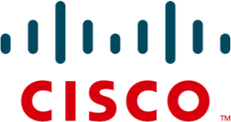

MODERNIZE DEVELOPMENT
CHALLENGE
Leading financial analytics software provider, with solutions to calculate risk such as FICO credit score
Wanted to expand their business by diversifying their offerings and serving new markets
Decided to build a new FICO Analytics Cloud to enable online access to FICO tools & services
BENEFITS
Allows FICO clients to get faster time to value
Improved IT operational efficiency
OpenShift also provides an embedded solution for on-premise platform delivery
CHALLENGE
Customers want more on-demand enterprise web & mobile apps
Needed faster time to market for new CA SaaS offerings
Wanted a common platform for multiple product teams to build apps on
BENEFITS
Enables product teams to more quickly build, deploy and update apps
Able to experiment and take apps from concept to production faster
Containers provide better utilization of hardware and horizontal scaling
CHALLENGE
Cisco IT organization has to support thousand of application developers
Built out large virtualization farm to provide developer environments (over 15,000 JVMs deployed)
Needed to improve developer productivity and expand access to new languages/frameworks
BENEFITS
Automated provisioning for developers via new Lightweight Application Environment (LAE)
Able to offer standardized stacks for different languages including Java and Node.js
Containers provide better infrastructure utilization and easier to manage operationally
https://www.youtube.com/watch?feature=player_embedded&v=ZMNilG8dPiM
www.openshift.com/customers
Notes:
Improving Agility by Modernizing Development and Operations
With resources now free from handling each and every inbound request for an environment and being confident that those environments are running efficiently and securely on the right providers operations teams can begin to work with development teams to design new processes for their cloud native applications.
These newly designed processes and cross-functional team structure combined with a platforms that supports running the broadest amount of languages and frameworks within microservices based architectures will enable the development and operations teams to achieve higher release frequencies. By utilizing microservices and standardized platforms and configurations these new applications will allow for independent release and scaling of components of the application.
This results in an increased success rate of change, faster cycle time, and the ability to scale specific services independently, making the life of both development and operations teams easier and allowing them to meet the needs of the line of business. We have experience doing this with very large software development organizations [11].

Slide 21
THE CHALLENGE
ENABLING DEVOPS IN A BI-MODAL WORLD
ACCELERATE DELIVERY
RELEVANCE
AGILITY
MODERNIZE DEVELOPMENT
AND OPERATIONS
OPTIMIZE IT
LESS COMPLEX
SCALABILITY
DELIVER CLOUD INFRASTRUCTURE
AND APPLICATIONS
Physical
Virtual
Private
Public
Self-Service
Automation
Re-usable Descriptions
Configuration Management
Content Management
Red Hat Cloud Infrastructure
Red Hat CloudForms
Red Hat Satellite
Red Hat Enterprise Virtualization
RHEL OpenStack Platform
Red Hat Enterprise Linux
Red Hat Storage
Microservices Architectures
Container Based Applications
Dynamic Scheduling
Continuous Integration and Delivery
Red Hat Cloud Suite for Applications
OpenShift Enterprise
Red Hat CloudForms
Red Hat Satellite
RHEL OpenStack Platform
JBoss Middleware
Red Hat Storage
Red Hat Cloud Infrastructure
Red Hat CloudForms
Red Hat Satellite
Red Hat Enterprise Virtualization
RHEL OpenStack Platform
Red Hat Enterprise Linux
Capacity Mgmt and Chargeback
Audit and Control Policies
Standard Operating Environment
Intelligent Workload Placement
Red Hat Storage
Forecasting and Trending
Increased Performance/Security
Improved Vendor Relations
Asynchronous Design
API Driven Infrastructure
Software Defined Networking and Storage
Quota Enforcement
Analytics, Alerting, Monitoring
Notes:
James

Slide 22
PUBLIC CLOUD LIKE INFRASTRUCTURE
EXAMPLE
SCALE-UP
Financially and Technically Unsustainable
DO-IT-YOURSELF SCALE-OUT
Complex and Incomplete
Network
Chargeback
Network
Network-Service
N
N
N
N
Self-Service
Network
Compute
Compute
Compute-Service
Compute
Audit
Storage
Storage
C
C
C
C
Storage
Control Policies
Storage-Service
$$
$$$$$
??????
Control Policies
S
S
S
S
“How can I use commodity servers to create pools of computing and storage to control costs at scale?”
“How can I provide a distributed asynchronous architecture for massive scalability?”
“How can I deploy, and update this cloud infrastructure securely and without causing outages for tenant workloads?”
“How can I manage a federated cloud infrastructure and use information on utilization to forecast future needs?”
“How do I bring enterprise manageability features to a cloud infrastructure platform like chargeback, quotas, and control policies?”
Head of
Operations
Notes:
Scalability with Programmable Infrastructure
As agility of development and operations processes is improved and release frequency increased, so to does the demand for more scalable infrastructure to run those releases on. Operations teams face the challenge of delivering infrastructure that will scale to meet the demand of this ever-growing number of applications. The last thing the head of operations would like to have to explain to the management team of a company is why an extremely successful new application was hitting a wall as to the maximum number of users it could support. This simply can’t happen. Unfortunately, the current infrastructure is not scalable, neither from a financial nor technical standpoint.
One option might be to build out a scale-out infrastructure, perhaps based on OpenStack, the leading open source project for infrastructure-as-a-service. However, the operations team doesn’t want to spend it’s time taking open source code and making it consumable and sustainable for the enterprise. It doesn’t have the resources to test and certify that OpenStack will work with each new piece of hardware it brings in. It also can’t afford to maintain the code base for long periods of time with the resources available. Finally, OpenStack is missing key features that operations needs and they don’t want to develop those in house as well.
What operations really needs is a way to minimize cost and increase scale through the use of commodity hardware and a massively scalable distributed architecture coupled with the enterprise management features required to operate that infrastructure and a stable, tested, certified way of consuming the open source projects that make up that infrastructure. By having this, operations can deploy scale-out infrastructure in multiple locations and still aggregate management functions like chargeback, utilization, governance, and workflows into a single logical location. Many of our customers have found this solution beneficial in reducing cost and ensuring stability at scale [12].

Slide 23
PUBLIC CLOUD LIKE INFRASTRUCTURE
EXAMPLE
ENTERPRISE GRADE SCALE-OUT CLOUD INFRASTRUCTURE
Consumable and Complete
Chargeback
Self-Service
Audit
Control Policies
Workflow
Network-Service
Network-Service
Network-Service
N
N
N
N
N
N
N
N
N
N
N
N
Compute-Service
Compute-Service
Compute-Service
Operator
C
C
C
C
C
C
C
C
C
C
C
C
Storage-Service
Operator
Operator
Storage-Service
Storage-Service
S
S
S
S
S
S
S
S
S
S
S
S
New York
London
Tokyo
Reducing Cost with Commodity Hardware
Massively Scalable Distributed Architecture
Deploy and Update Securely while Ensuring Tenant Uptime
Forecast Capacity Requirements based on Utilization
Deliver enterprise functionality required for private cloud
Head of
Operations
Notes:
Scalability with Programmable Infrastructure
As agility of development and operations processes is improved and release frequency increased, so to does the demand for more scalable infrastructure to run those releases on. Operations teams face the challenge of delivering infrastructure that will scale to meet the demand of this ever-growing number of applications. The last thing the head of operations would like to have to explain to the management team of a company is why an extremely successful new application was hitting a wall as to the maximum number of users it could support. This simply can’t happen. Unfortunately, the current infrastructure is not scalable, neither from a financial nor technical standpoint.
One option might be to build out a scale-out infrastructure, perhaps based on OpenStack, the leading open source project for infrastructure-as-a-service. However, the operations team doesn’t want to spend it’s time taking open source code and making it consumable and sustainable for the enterprise. It doesn’t have the resources to test and certify that OpenStack will work with each new piece of hardware it brings in. It also can’t afford to maintain the code base for long periods of time with the resources available. Finally, OpenStack is missing key features that operations needs and they don’t want to develop those in house as well.
What operations really needs is a way to minimize cost and increase scale through the use of commodity hardware and a massively scalable distributed architecture coupled with the enterprise management features required to operate that infrastructure and a stable, tested, certified way of consuming the open source projects that make up that infrastructure. By having this, operations can deploy scale-out infrastructure in multiple locations and still aggregate management functions like chargeback, utilization, governance, and workflows into a single logical location. Many of our customers have found this solution beneficial in reducing cost and ensuring stability at scale [12].

Slide 24
PUBLIC CLOUD LIKE INFRASTRUCTURE
Leading Healthcare Provider
Provided a unified cloud environment with the functionality and scalability benefits of Amazon, which was seen as a viable alternative for internal teams
Internal private cloud provides increased security and protection from security threats and data breaches
Control of environment allows for leveraging existing hardware purchases
Large European Bank
Secure and controlled Infrastructure as a Service environment for agile computing
Improved reliability using a highly available architecture and design
Structured approach to integrating private and public Infrastructure as a Service
Notes:
Scalability with Programmable Infrastructure
As agility of development and operations processes is improved and release frequency increased, so to does the demand for more scalable infrastructure to run those releases on. Operations teams face the challenge of delivering infrastructure that will scale to meet the demand of this ever-growing number of applications. The last thing the head of operations would like to have to explain to the management team of a company is why an extremely successful new application was hitting a wall as to the maximum number of users it could support. This simply can’t happen. Unfortunately, the current infrastructure is not scalable, neither from a financial nor technical standpoint.
One option might be to build out a scale-out infrastructure, perhaps based on OpenStack, the leading open source project for infrastructure-as-a-service. However, the operations team doesn’t want to spend it’s time taking open source code and making it consumable and sustainable for the enterprise. It doesn’t have the resources to test and certify that OpenStack will work with each new piece of hardware it brings in. It also can’t afford to maintain the code base for long periods of time with the resources available. Finally, OpenStack is missing key features that operations needs and they don’t want to develop those in house as well.
What operations really needs is a way to minimize cost and increase scale through the use of commodity hardware and a massively scalable distributed architecture coupled with the enterprise management features required to operate that infrastructure and a stable, tested, certified way of consuming the open source projects that make up that infrastructure. By having this, operations can deploy scale-out infrastructure in multiple locations and still aggregate management functions like chargeback, utilization, governance, and workflows into a single logical location. Many of our customers have found this solution beneficial in reducing cost and ensuring stability at scale [12].

Slide 25
THE CHALLENGE
ENABLING DEVOPS IN A BI-MODAL WORLD
ACCELERATE DELIVERY
RELEVANCE
AGILITY
MODERNIZE DEVELOPMENT
AND OPERATIONS
OPTIMIZE IT
LESS COMPLEX
SCALABILITY
DELIVER CLOUD INFRASTRUCTURE
AND APPLICATIONS
Physical
Virtual
Private
Public
Self-Service
Automation
Re-usable Descriptions
Configuration Management
Content Management
Red Hat Cloud Infrastructure
Red Hat CloudForms
Red Hat Satellite
Red Hat Enterprise Virtualization
RHEL OpenStack Platform
Red Hat Enterprise Linux
Red Hat Storage
Microservices Architectures
Container Based Applications
Dynamic Scheduling
Continuous Integration and Delivery
Red Hat Cloud Suite for Applications
OpenShift Enterprise
Red Hat CloudForms
Red Hat Satellite
RHEL OpenStack Platform
JBoss Middleware
Red Hat Storage
Red Hat Cloud Infrastructure
Red Hat CloudForms
Red Hat Satellite
Red Hat Enterprise Virtualization
RHEL OpenStack Platform
Red Hat Enterprise Linux
Capacity Mgmt and Chargeback
Audit and Control Policies
Standard Operating Environment
Intelligent Workload Placement
Red Hat Storage
Forecasting and Trending
Increased Performance/Security
Improved Vendor Relations
Asynchronous Design
API Driven Infrastructure
Software Defined Networking and Storage
Quota Enforcement
Analytics, Alerting, Monitoring
Red Hat Cloud Infrastructure
Red Hat CloudForms
Red Hat Satellite
RHEL OpenStack Platform
Red Hat Enterprise Linux
Red Hat Storage
Red Hat Storage
Notes:
Scalability with Programmable Infrastructure
As agility of development and operations processes is improved and release frequency increased, so to does the demand for more scalable infrastructure to run those releases on. Operations teams face the challenge of delivering infrastructure that will scale to meet the demand of this ever-growing number of applications. The last thing the head of operations would like to have to explain to the management team of a company is why an extremely successful new application was hitting a wall as to the maximum number of users it could support. This simply can’t happen. Unfortunately, the current infrastructure is not scalable, neither from a financial nor technical standpoint.
One option might be to build out a scale-out infrastructure, perhaps based on OpenStack, the leading open source project for infrastructure-as-a-service. However, the operations team doesn’t want to spend it’s time taking open source code and making it consumable and sustainable for the enterprise. It doesn’t have the resources to test and certify that OpenStack will work with each new piece of hardware it brings in. It also can’t afford to maintain the code base for long periods of time with the resources available. Finally, OpenStack is missing key features that operations needs and they don’t want to develop those in house as well.
What operations really needs is a way to minimize cost and increase scale through the use of commodity hardware and a massively scalable distributed architecture coupled with the enterprise management features required to operate that infrastructure and a stable, tested, certified way of consuming the open source projects that make up that infrastructure. By having this, operations can deploy scale-out infrastructure in multiple locations and still aggregate management functions like chargeback, utilization, governance, and workflows into a single logical location. Many of our customers have found this solution beneficial in reducing cost and ensuring stability at scale [12].

Slide 26
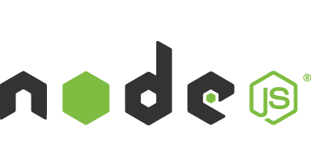
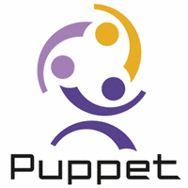
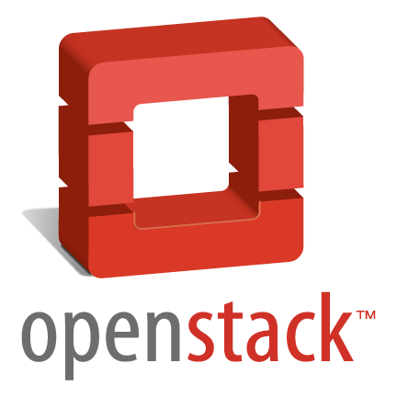
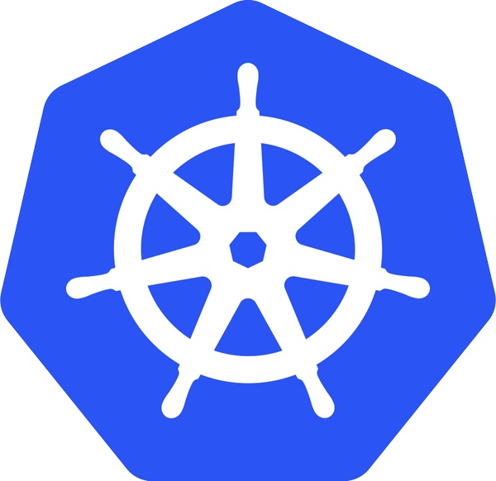






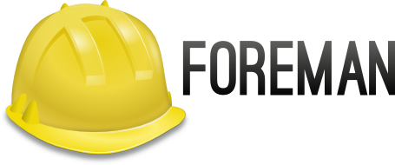
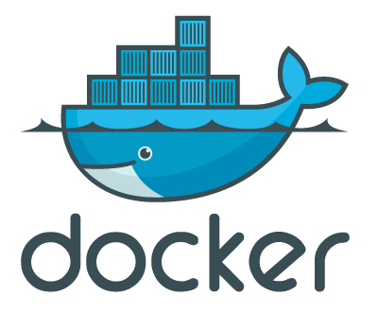
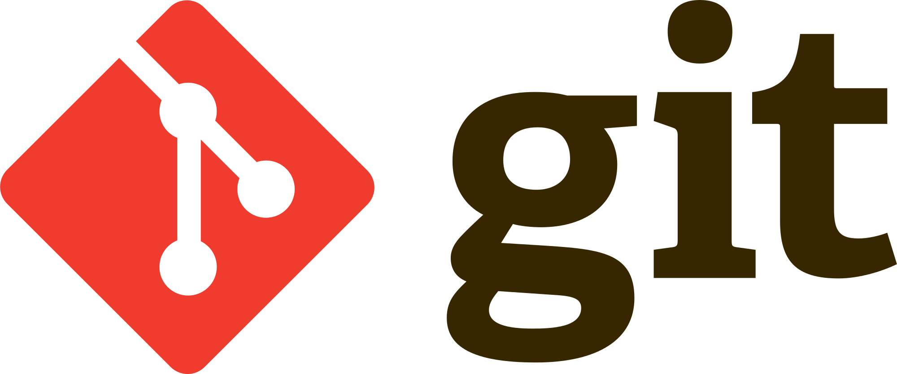

OPEN SOURCE
DRIVING DEVOPS, CLOUD APPS, AND INFRASTRUCTURE
Notes:
All things are being driven by Open Source

Slide 27

YESTERDAY’S CHOICES
INNOVATION
INTEGRATION
Enterprise Support
Input into New Features
Tested, Stable, Certified
Rapid Bug Fixes & Predictable Lifecycles
Advanced Functionality
X
X
X
Large Engineering Investment
Difficulty Integrating Disparate Projects and Supporting Lifecycle
Not the Core Business
X
X
According to the Linux Foundation’s Global 2013 Survey
76% of clouds are built on open source technologies
Notes:
Introducing Red Hat Cloud Suite
Red Hat Cloud Suite is a family of suites from Red Hat that brings together all the award winning products from Red Hat in a consistent way to solve specific problems. It allows IT to accelerate service delivery and optimize their existing assets while allowing them to build their next generation infrastructure and application platforms to support massive salability and more agile development and operations processes. In other words, it meets them where they are and lays the foundation for where they want to go.
A Different Approach
It should come as no surprise to you that Red Hat is not the only company solving these problems. Red Hat is, however, one of the few companies that can solve all of these problems because of its broad portfolio of technologies and expertise. Most think of Red Hat as having the largest percentage of the paid Linux market share. That is true, but Red Hat has been adding to its portfolio and has grown acquired expertise and industry leading technology from Software Defined Storage [13][14] to Mobile Development Platforms [15]. These offerings place Red Hat alone with only Microsoft in terms of depth of capability.
An Important Difference
Along with this depth of expertise and capability comes an approach that sets Red Hat apart. Red Hat is the only vendor that uses an open source development model for all of the solutions it delivers. This is important for customers because the world of cloud infrastructure and applications and DevOps is built entirely on open source software. By having a strict open source only mentality customers can have access to the greatest amount of innovation and be ensured that as technologies change they could adopt them more easily because Red Hat can adopt and deliver these technologies. Two great examples of this are how Red Hat adopted the KVM hypervisor [16] and embraced and delivered it’s container platform with support for Docker and Kubernetes [17] - leading open source projects that become popular in a short amount of time. Red Hat is committed to the open source development model, so much so that it even creates communities when it acquires non-open source licensed technologies [18]. Customers should know that when they leverage a solution from Red Hat it is based entirely on open source, leading to greater access to innovation and lower exit costs.

Slide 28
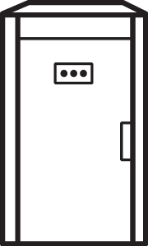


YESTERDAY’S CHOICES
INNOVATION
INTEGRATION
X
$$$
High Price Tag
Vendor Controlled Innovation
High Exit Cost due
to Proprietary Model
According to Information Week’s 2014 Private Cloud Survey
54% indicated that integrating and protecting their cloud infrastructure is their primary challenge
Notes:
Introducing Red Hat Cloud Suite
Red Hat Cloud Suite is a family of suites from Red Hat that brings together all the award winning products from Red Hat in a consistent way to solve specific problems. It allows IT to accelerate service delivery and optimize their existing assets while allowing them to build their next generation infrastructure and application platforms to support massive salability and more agile development and operations processes. In other words, it meets them where they are and lays the foundation for where they want to go.
A Different Approach
It should come as no surprise to you that Red Hat is not the only company solving these problems. Red Hat is, however, one of the few companies that can solve all of these problems because of its broad portfolio of technologies and expertise. Most think of Red Hat as having the largest percentage of the paid Linux market share. That is true, but Red Hat has been adding to its portfolio and has grown acquired expertise and industry leading technology from Software Defined Storage [13][14] to Mobile Development Platforms [15]. These offerings place Red Hat alone with only Microsoft in terms of depth of capability.
An Important Difference
Along with this depth of expertise and capability comes an approach that sets Red Hat apart. Red Hat is the only vendor that uses an open source development model for all of the solutions it delivers. This is important for customers because the world of cloud infrastructure and applications and DevOps is built entirely on open source software. By having a strict open source only mentality customers can have access to the greatest amount of innovation and be ensured that as technologies change they could adopt them more easily because Red Hat can adopt and deliver these technologies. Two great examples of this are how Red Hat adopted the KVM hypervisor [16] and embraced and delivered it’s container platform with support for Docker and Kubernetes [17] - leading open source projects that become popular in a short amount of time. Red Hat is committed to the open source development model, so much so that it even creates communities when it acquires non-open source licensed technologies [18]. Customers should know that when they leverage a solution from Red Hat it is based entirely on open source, leading to greater access to innovation and lower exit costs.

Slide 29

AN ALTERNATIVE
INNOVATION AND INTEGRATION
$$$$
Large Engineering Investment
Difficulty Integrating Disparate Projects and Supporting Lifecycle
Not the Core Business
Well Integrated to Reduce Investment
Access to Open Innovation
Delivers De Facto Standards for Enterprises
High Price Tag
Vendor Controlled Innovation
High Exit Cost due
to Proprietary Model
Notes:
Introducing Red Hat Cloud Suite
Red Hat Cloud Suite is a family of suites from Red Hat that brings together all the award winning products from Red Hat in a consistent way to solve specific problems. It allows IT to accelerate service delivery and optimize their existing assets while allowing them to build their next generation infrastructure and application platforms to support massive salability and more agile development and operations processes. In other words, it meets them where they are and lays the foundation for where they want to go.
A Different Approach
It should come as no surprise to you that Red Hat is not the only company solving these problems. Red Hat is, however, one of the few companies that can solve all of these problems because of its broad portfolio of technologies and expertise. Most think of Red Hat as having the largest percentage of the paid Linux market share. That is true, but Red Hat has been adding to its portfolio and has grown acquired expertise and industry leading technology from Software Defined Storage [13][14] to Mobile Development Platforms [15]. These offerings place Red Hat alone with only Microsoft in terms of depth of capability.
An Important Difference
Along with this depth of expertise and capability comes an approach that sets Red Hat apart. Red Hat is the only vendor that uses an open source development model for all of the solutions it delivers. This is important for customers because the world of cloud infrastructure and applications and DevOps is built entirely on open source software. By having a strict open source only mentality customers can have access to the greatest amount of innovation and be ensured that as technologies change they could adopt them more easily because Red Hat can adopt and deliver these technologies. Two great examples of this are how Red Hat adopted the KVM hypervisor [16] and embraced and delivered it’s container platform with support for Docker and Kubernetes [17] - leading open source projects that become popular in a short amount of time. Red Hat is committed to the open source development model, so much so that it even creates communities when it acquires non-open source licensed technologies [18]. Customers should know that when they leverage a solution from Red Hat it is based entirely on open source, leading to greater access to innovation and lower exit costs.

Slide 30

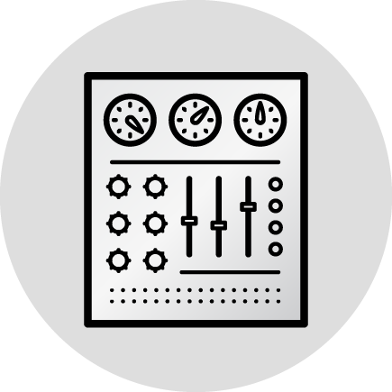


UNPARALLELED CAPABILITIES
UNRESTRICTED DEVELOPMENT
HYBRID OPERATIONS
OPTIMIZED WITH ANALYTICS
COMPLETE LIFECYCLE
Notes:
Technical Capabilities are Important Too
While philosophical differences are important for ensuring that the right long term decisions have been made, Red Hat is also at the forefront of innovation in cloud infrastructure, applications, and DevOps tools.

Slide 31
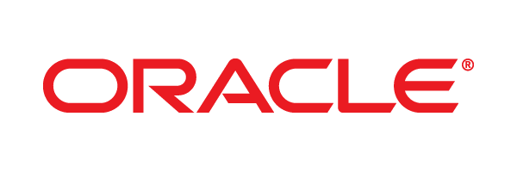
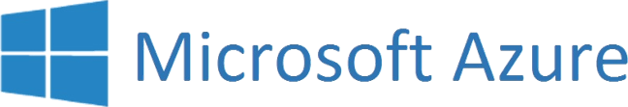
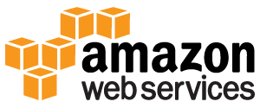

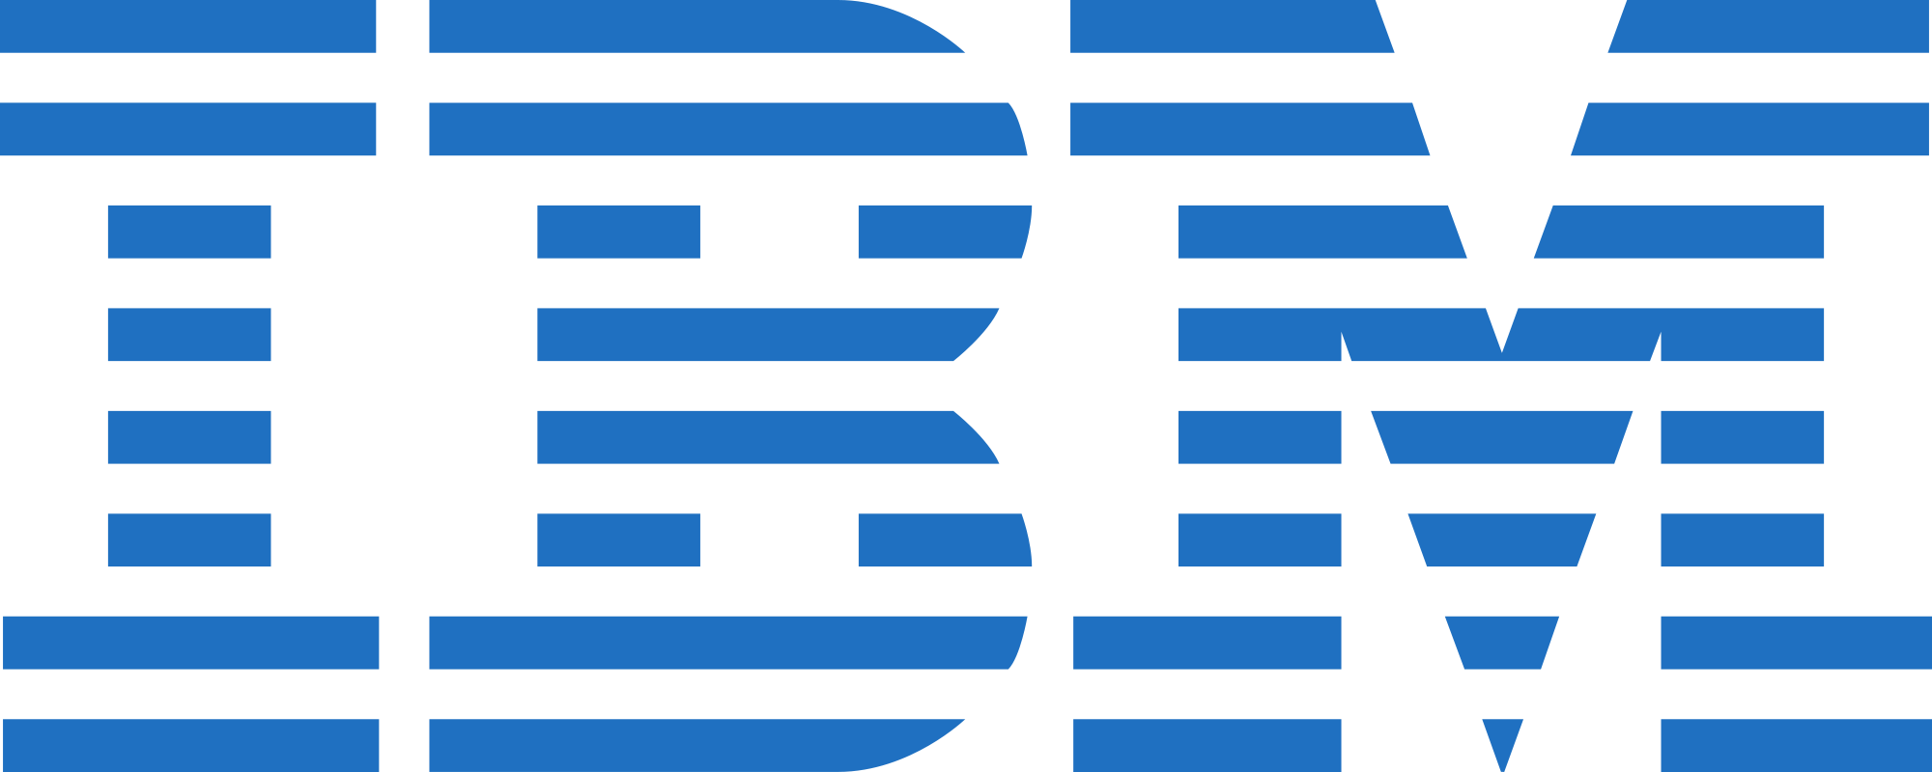

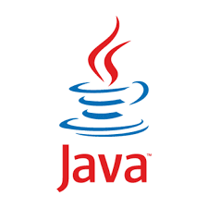
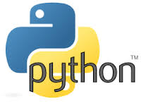
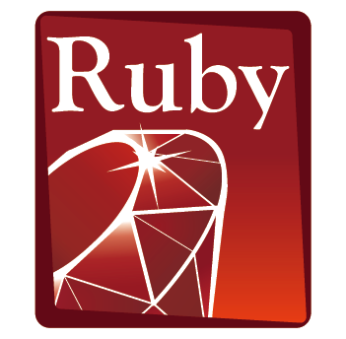
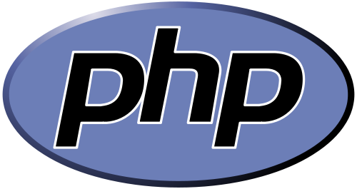

UNRESTRICTED DEVELOPMENT
Containers? VMs? Services?
Great … but what about these?
Insert your service or VM based application or here
… and how do I define operations management for this new application during development?
Service Catalog
Developer
Operations
Notes:
True Hybrid Support
The term hybrid cloud has often been over used and abused, but it is important. Enterprises need to be able to run workloads across the four major deployment models that exist today: physical, virtual, private, and public cloud. Equally as important to the deployment model is the ability to support multiple service models, such infrastructure-as-a-service, platform-as-a-service, or even bare metal, virtual machines running on scale-up virtual infrastructure, and public cloud services. When most vendors claim they support “hybrid” cloud they are typically limited to only managing hybrid deployment models. Red Hat supports both hybrid deployment models and hybrid service models. This is important to both Development and Operations teams. For developers, it means being able to develop on the broadest choice of languages and frameworks. They could use an Oracle database running on bare-metal or virtual machine, JBoss EAP running on virtual machines on OpenStack, combined with Node.js and Ruby running in Containers on OpenShift. They are not constrained to a single service model that doesn’t give them everything they need.

Slide 32
UNRESTRICTED DEVELOPMENT
Containers? VMs? Services? Yes Please!
Developer
Stateful VMs
Stateless VMs
Containers
External Services
Environment
Operations
To Other
Environments
Reports
Policies
Content
Configuration
Environment Description
Kubernetes
Pods
Heat
Templates
OpenShift
CloudForms
Satellite
Content Views
Reports &
Policies
OpenStack
VM
Templates
Automate
Methods
Red Hat Enterprise Virtualization
Notes:
True Hybrid Support
The term hybrid cloud has often been over used and abused, but it is important. Enterprises need to be able to run workloads across the four major deployment models that exist today: physical, virtual, private, and public cloud. Equally as important to the deployment model is the ability to support multiple service models, such infrastructure-as-a-service, platform-as-a-service, or even bare metal, virtual machines running on scale-up virtual infrastructure, and public cloud services. When most vendors claim they support “hybrid” cloud they are typically limited to only managing hybrid deployment models. Red Hat supports both hybrid deployment models and hybrid service models. This is important to both Development and Operations teams. For developers, it means being able to develop on the broadest choice of languages and frameworks. They could use an Oracle database running on bare-metal or virtual machine, JBoss EAP running on virtual machines on OpenStack, combined with Node.js and Ruby running in Containers on OpenShift. They are not constrained to a single service model that doesn’t give them everything they need.

Slide 33

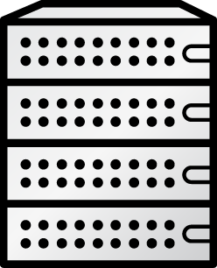
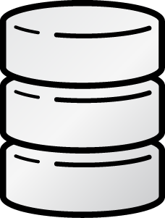
HYBRID OPERATIONS
Containers? VMs? Services?
What happens if I take this rack down?
What container based apps will be effected?
Is what’s in that container secure?
Operations
Notes:
True Hybrid Support
The term hybrid cloud has often been over used and abused, but it is important. Enterprises need to be able to run workloads across the four major deployment models that exist today: physical, virtual, private, and public cloud. Equally as important to the deployment model is the ability to support multiple service models, such infrastructure-as-a-service, platform-as-a-service, or even bare metal, virtual machines running on scale-up virtual infrastructure, and public cloud services. When most vendors claim they support “hybrid” cloud they are typically limited to only managing hybrid deployment models. Red Hat supports both hybrid deployment models and hybrid service models. This is important to both Development and Operations teams. For developers, it means being able to develop on the broadest choice of languages and frameworks. They could use an Oracle database running on bare-metal or virtual machine, JBoss EAP running on virtual machines on OpenStack, combined with Node.js and Ruby running in Containers on OpenShift. They are not constrained to a single service model that doesn’t give them everything they need.

Slide 34
HYBRID OPERATIONS
Containers? VMs? Services? Yes Please!
RED HAT
CLOUDFORMS
Infrastructure
Containers
Applications
HW Faults
RH ATOMIC ENTERPRISE PLATFORM
OPENSHIFT BY RED HAT
OpenStack
Utilization
Recommendation Engine
vSphere
Networking
Down Route
Public Cloud
Transaction Processing
Service API Down
RHEV
Built Fault
Mobile Ad Placement
Canary Failure
Hyper-V
Notes:
True Hybrid Support
The term hybrid cloud has often been over used and abused, but it is important. Enterprises need to be able to run workloads across the four major deployment models that exist today: physical, virtual, private, and public cloud. Equally as important to the deployment model is the ability to support multiple service models, such infrastructure-as-a-service, platform-as-a-service, or even bare metal, virtual machines running on scale-up virtual infrastructure, and public cloud services. When most vendors claim they support “hybrid” cloud they are typically limited to only managing hybrid deployment models. Red Hat supports both hybrid deployment models and hybrid service models. This is important to both Development and Operations teams. For developers, it means being able to develop on the broadest choice of languages and frameworks. They could use an Oracle database running on bare-metal or virtual machine, JBoss EAP running on virtual machines on OpenStack, combined with Node.js and Ruby running in Containers on OpenShift. They are not constrained to a single service model that doesn’t give them everything they need.

Slide 35
HYBRID OPERATIONS
DEMONSTRATION
Notes:
Run video of CloudForms/OSE Demonstration

Slide 36
OPTIMIZED WITH ANALYTICS
REACTIVE SUPPORT IS GOOD
… is this configured securely?
… is this optimized for performance?
… has anyone had a driver issue like this before?
Administrator
Notes:
Using Big Data to Optimize IT
Red Hat has been supporting Linux for a long time. In fact, we’ve been supporting Red Hat Enterprise Linux for over 13 years since RHEL AS 2.1’s release in 2002 [16]. There are over 700 Red Hat Certified Engineers in our support organization and they’ve documented over 30,000 solutions while resolving over 1 million technical issues. The Red Hat customer portal has won plenty of awards for helping connect customers searching for resolution to an issue to the right technical solution. With Red Hat Access Insights, Red Hat’s new predictive analytics service, connecting support data to recommendations is going to reach a new level of ease of use. Users can send small amounts of data about their environment back to Red Hat and it will be compared to optimal configurations to find opportunities to improve security, reliability, availability, and performance. This service is already available for Red Hat Enterprise Linux and will soon be available for all the technologies in Red Hat’s portfolio through Red Hat Cloud Suite.

Slide 37


OPTIMIZED WITH ANALYTICS
PROACTIVE SUPPORT IS BETTER
700+
Red Hat Certified Engineers
30,000+
Documented Technical Solutions
1,000,000+
Resolved Technical Issues
Notes:
Using Big Data to Optimize IT
Red Hat has been supporting Linux for a long time. In fact, we’ve been supporting Red Hat Enterprise Linux for over 13 years since RHEL AS 2.1’s release in 2002 [16]. There are over 700 Red Hat Certified Engineers in our support organization and they’ve documented over 30,000 solutions while resolving over 1 million technical issues. The Red Hat customer portal has won plenty of awards for helping connect customers searching for resolution to an issue to the right technical solution. With Red Hat Access Insights, Red Hat’s new predictive analytics service, connecting support data to recommendations is going to reach a new level of ease of use. Users can send small amounts of data about their environment back to Red Hat and it will be compared to optimal configurations to find opportunities to improve security, reliability, availability, and performance. This service is already available for Red Hat Enterprise Linux and will soon be available for all the technologies in Red Hat’s portfolio through Red Hat Cloud Suite.

Slide 38
ANALYTICS
DEMONSTRATION
Notes:
Run Video

Slide 39


COMPLETE LIFECYCLE
Deploying and Updating a Private Cloud is Difficult
Configuration Management
Content Synchronization
Just give me a few months ...
Configurations
Platform as a Service
Environments
Users, Teams, Projects
… Many More ...
Logging
image builder
scheduler config
Operations
Management Platform
Virtualization
Infrastructure as a Service
Infrastructure Providers
Hosts
Manager
Network
Services
Storage Services
Capacity and Utilization
Identity Configuration
Compute
Services
… Many More ...
Clusters
Overcommit
Settings
Infrastructure Services
Consultants
$$$
DHCP
DNS
TFTP/PXE
Notes:
An Easy On-ramp and Consistent Lifecycle
Deploying a private cloud is not an easy task. The list of platforms that need to come together from configuration management, to storage, to infrastructure-as-a-service, to platform-as-a-service is large. Each of these has dependencies on sub-components within each of these platforms. For example, to generate new docker images need secure content and that takes integration between the content management system and the image building services. Literally hundreds of these integrations are needed to build a fully functional private cloud. This usually results in one of two options:
Operations requiring lots and lots of time to deliver this private cloud.
An army of high priced consultants arriving to deliver and maintain a private cloud.
Neither of these options are an optimal results for IT. Red Hat Cloud Suite provides an easy on-ramp that allows a single person in operations to deploy a private cloud and it provides the path for ongoing management of that private cloud. This allows developers to begin using the private cloud more quickly and helps operations deliver a private cloud more quickly.

Slide 40
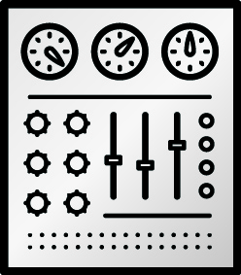
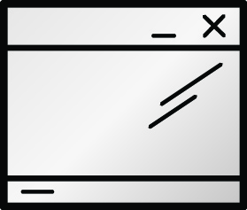



COMPLETE LIFECYCLE
Start Quickly, Manage Completely
Operator
Developer
Ongoing
Management
+
=
Notes:
An Easy On-ramp and Consistent Lifecycle
Deploying a private cloud is not an easy task. The list of platforms that need to come together from configuration management, to storage, to infrastructure-as-a-service, to platform-as-a-service is large. Each of these has dependencies on sub-components within each of these platforms. For example, to generate new docker images need secure content and that takes integration between the content management system and the image building services. Literally hundreds of these integrations are needed to build a fully functional private cloud. This usually results in one of two options:
Operations requiring lots and lots of time to deliver this private cloud.
An army of high priced consultants arriving to deliver and maintain a private cloud.
Neither of these options are an optimal results for IT. Red Hat Cloud Suite provides an easy on-ramp that allows a single person in operations to deploy a private cloud and it provides the path for ongoing management of that private cloud. This allows developers to begin using the private cloud more quickly and helps operations deliver a private cloud more quickly.

Slide 41
LIFECYCLE
DEMONSTRATION
Notes:
Run Video

Slide 42
RED HAT SOLUTIONS
THE WORLD IS CHANGING
BUSINESSES NEED A CONTINUOUS COMPETITIVE ADVANTAGE
ALL BUSINESSES ARE SOFTWARE COMPANIES
COMPETITION IS EVERYWHERE
IT NEEDS
TO INCREASE RELEVANCE AND REDUCE COMPLEXITY
TO CREATE MORE AGILE PROCESSES AND BUILD PROGRAMMABLE &
SCALABLE INFRASTRUCTURE AND PLATFORMS
RED HAT HELPS
ACCELERATE DELIVERY
OPTIMIZE IT
MODERNIZE DEVELOPMENT AND OPERATIONS
DELIVER SCALABLE INFRASTRUCTURE
ONLY RED HAT CAN DELIVER
INNOVATION IN THE FORM OF PURE OPEN SOURCE SOLUTIONS
INTEGRATION WITH WORLD CLASS TESTING, SUPPORT, AND CERTIFICATION
Notes:
Summarizing

Slide 43
Notes:
Thomas - Go forth and conquer

